Slide 1
Data Structures
ICT-1211
Information and Communication Technology
Lecture-07
Date:

Slide 2
Arrays, Records and Pointers

Slide 3
Data structures are classified as either Linear or Nonlinear.
A data structure is said to be Linear if its elements forms a sequence, or a linear list.
There are TWO basic ways of representing such linear structures in memory.
    One ways is to have the linear relationship between the elements represented by means of sequential memory locations. (For example, ARRAYS).
    The other ways is to have the linear relationship between the elements represented by mean of pointers or links. (For example, linked lists)
Nonlinear data structures (For example, tress and graphs) discussed later.

Slide 4
Operations on Linear Structure
The operations one normally performed on any linear structure include the following:
Traversing-Processing each element in the list
Search – Finding the location of the element with a given value or the record with a given key.
Insertion-Adding a new element to the list.
Deletion-Removing an element from the list.
Sorting-Arranging the element in some type of order.
Merging-Combining two list into a single list.

Slide 5
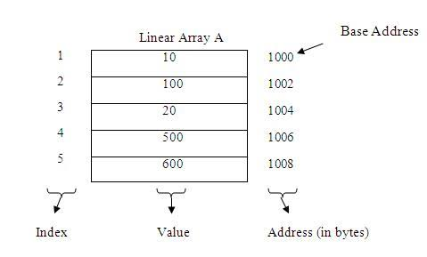
Linear Arrays
A linear array is a list of finite number n of HOMOGENEOUS data elements (i.e., data elements of the same type) such that:
  The elements of the array are referenced respectively by an index set consisting of n consecutive numbers.
  The elements of the array are stored respectively in successive memory locations.

Slide 6
Linear Arrays
The number n of elements is called the length or size of the array.
In general, the length or the number of data elements of the array can be obtained from the index set by the formula.
Length = UB - LB + 1
where UB is the largest index, called the upper bound, and LB is the smallest index, called the lower bound of the array.
Note that, Length = UB when LB = 1.

Slide 7
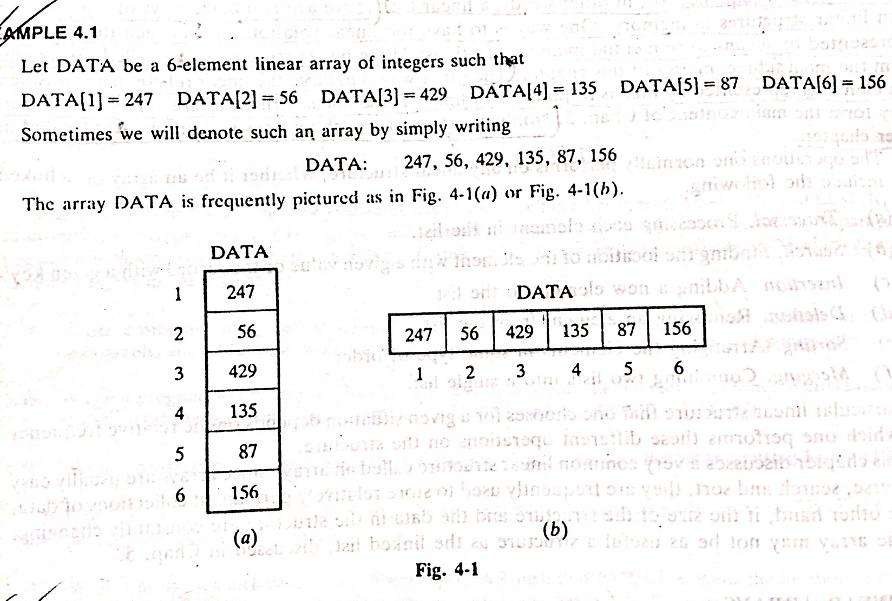
Linear Arrays: Example

Slide 8
Linear Arrays: Indexing Example
An automobile company uses an array AUTO to record the number of automobiles sold each year from 1930 through 1984.
Rather than beginning the index set with 1, it is more useful to begin the index set with 1930 so that
AUTO[K]=Number of automobiles sold in the year K,
Then, LB=1930 and UB=1984 of AUTO
Length=UB-LB+1
=1984-1930+1=55
On implementation, each programming language has its own rules for declaring arrays. Each such declaration must give, implicitly , THREE items of information,
      The NAME of the array,
      The DATA TYPES of the array
      The INDEX SET of the array

Slide 9
Representation of LA in Memory
Let LA be a linear array in the memory of the computer.
LOC(LA[K])=address of the element LA[K] of the array LA
The elements of LA are stored in successive memory cells.
Accordingly, the computer does not need to keep track of the address of every element of LA, But needs to keep track only the address of the first element of LA, denoted by
Base(LA)-called the base address of LA

Slide 10
Representation of LA in Memory
Using the base address of LA, the computer calculates the address of any element of LA by the following formula:
LOC(LA[K])=Base(LA)+w(K-lower bound)
w-is the number of words per memory cell for the array LA.
The time to calculate LOC (LA[K]) is essentially the same for any value of K.
Given any subscript K, one can locate and access the content of LA[K] without scanning any other element of LA.

Slide 11
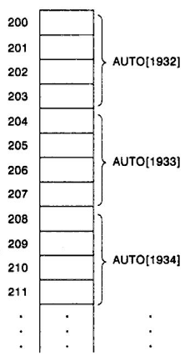
Example: Representation of LA in Memory
Consider the array AUTO which records the number of automobiles sold each year from 1932 through 1984.
Suppose AUTO appears in memory as pictured below
Here, Base (AUTO)=200, and
w=4 words per memory cell for AUTO.
LOC (AUTO[1932])= ?
200
LOC (AUTO[1933])= ?
204
LOC (AUTO[1934])= ?
208
Address of the array element for the year K=1965 can be obtained:
LOC(AUTO[1965])=Base(AUTO)+w(1965-lower bound)
= 200+4(1965-1932)=332
LOC(LA[K])=Base(LA)+w(K-lower bound)

Slide 12
Can Linear Arrays be indexed?
A collection A of data elements is said to be indexed if any element of A, which we shall call A_{k} , can be located and processed in the time that is independent of K.
This is very important property of linear arrays

Slide 13
Traversing Linear Arrays A: Algorithm
A is a linear array with LB and UB
Step 1. [Initialize counter] Set K:=LB
Step 2. Repeat Step 3 and 4 while K<=UB [Repeat while loop]
Step 3. [Visit element] Apply PROCESS to A[K].
Step 4. [Increase counter] Set K:=K+1.
[End of Step 2 loop.]
Step 5. Exit.
Step 1. Repeat for K=LB to UB [Repeat for loop]
[Visit element] Apply PROCESS to A[K].
[End of Step 2 loop.]
Step 2. Exit.
Notes:
Let A be a collection of data elements stored in the memory of the computer. Suppose we want to print the contents of each element of A or suppose we want to count the number of elements of A with a given properties. This can be accomplished by traversing A, by accessing and processing each element of A exactly once.

Slide 14
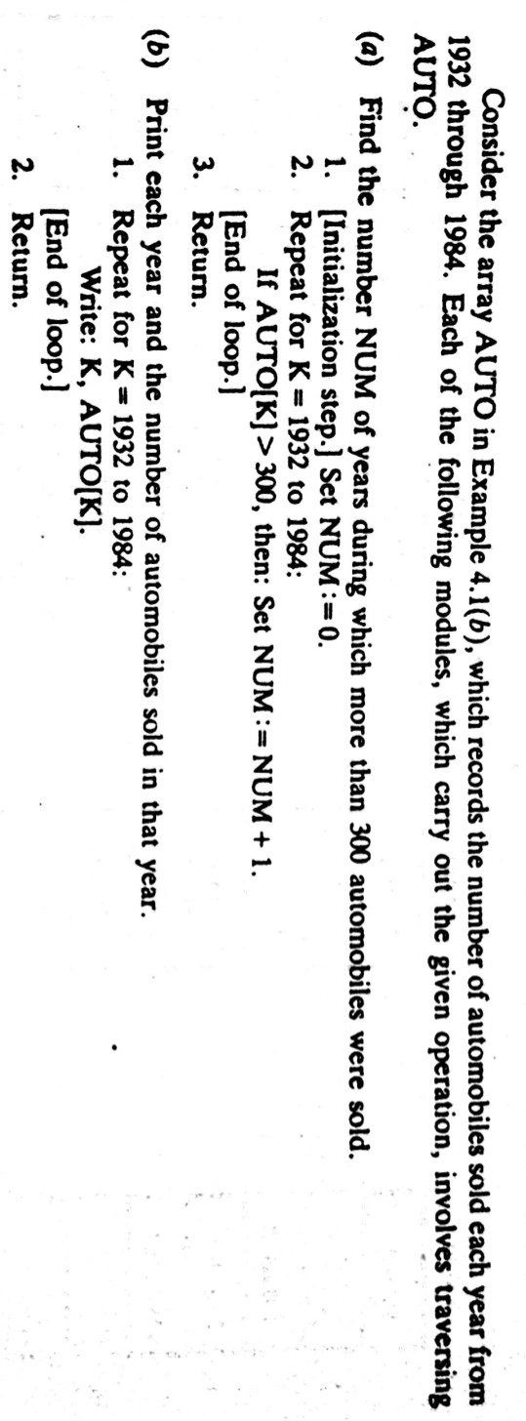
Traversing Linear Arrays: Example

Slide 15
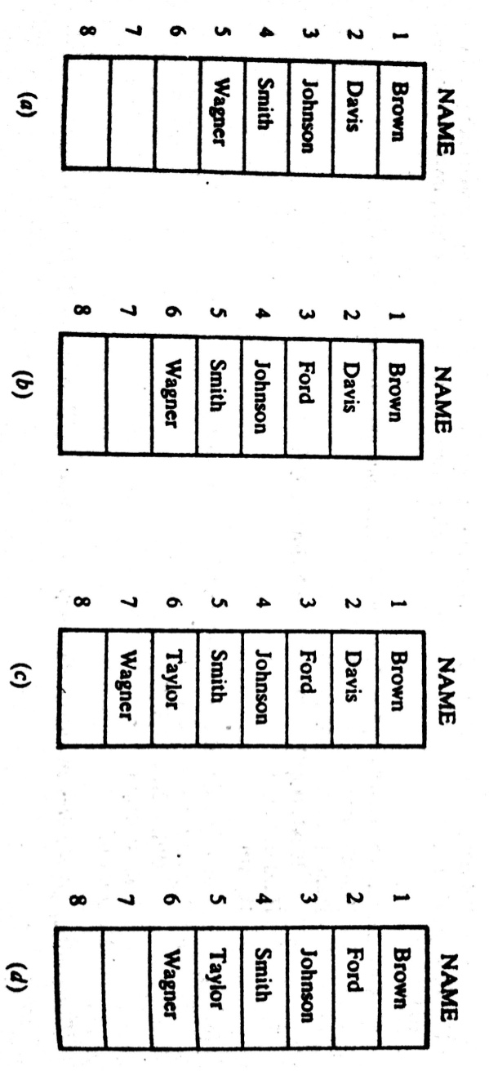
Inserting elements in a Linear Arrays:
Let A be a collection of data elements in the computer memory.
Inserting refer to the operation of ADDING another element to the collection.
Inserting an element at the “end” of the linear array can be EASILY done provided the memory space allocating for the array is large enough to accommodate the additional element.
Inserting an element in the middle of the array is RELATIVELY COMPLICATED TASK.
On an average, half of the elements must
be moved downward to new locations to
accommodate the elements and keep
the order of the other elements.

Slide 16
Inserting elements in a LA: Algorithm
INSERT(LA, N, K, ITEM) [inserts an element ITEM into Kth position in LA]
[Initialize counter] Set J:=N
Repeat Step 3 and 4 while J>=K.
[Move J^{th} element downward.] Set LA[J+1]:=LA[J]
[Decrease counter] Set J:=J-1.
    [End of Step 2 loop.]
[Insert element.] Set LA[K]:=ITEM.
[Reset N.] Set N:=N+1.
Exit.
The elements are moved in reverse order . First LA[N], then LA[N-1],…...and last LA[K]; otherwise data might be erased.
Notes:
Here LA is a linear array with N elements and K is a positive integer such that K<=N. The first 4 steps create space in LA by moving downward one location each element from the Kth position on. The elements are moved in reverse order . First LA[N], then LA[N-1],…...and last LA[K]; otherwise data might be erased.

Slide 17
Instant Test-1:
Consider the linear arrays:
AAA (10 : 55),
BBB (-10 : 15), and
EEE (25)
a) Find the number of element in each array.
We know Length=UB-LB+1
Accordingly, Length (AAA) = 55 - 10 + 1= 46
Length (BBB) = 15-(-10)+1 = 26
Length (EEE) = 25-1+1= 25

Slide 18
Instant Test-2:
Consider the linear arrays:
AAA (10 : 65),
AAA (-10 : 15), and
EEE (25)
b) Suppose Base (AAA) = 300 and w= 4 words per memory cell for AAA.
Find the address of AAA [15]
AAA [35]
AAA[75]
We know the formula: LOC (AAA[k])= Base (AAA)+w (k-LB)
Hence, LOC (AAA[15])= 300 + 4 (15-10) = 320
LOC (AAA [35])= 300 + 4 (35-10)= 400
AAA [75] is not an element of AAA, since 75 exceeds UB=65

Slide 19
Deleting elements from a Linear Arrays:
Deleting refers to the operation of removing one of the elements from A.
Deleting an element at the “end” of the linear array present no difficulties (EASILY).
But deleting an element somewhere in the middle of the array would require that each of the subsequent element be moved one location upward in order to fill-up the array.

Slide 20
Deleting elements from a LA: Algorithm
DELETE(LA, N, K, ITEM)
(This algorithm deletes the Kth element from LA)
Set ITEM:=LA[K]
Repeat for J=K to N-1:
[Move J+1th element upward.] Set LA[J]:=LA[J+1]
    [End of Step 2 loop.]
3. [Reset the number N of element in LA] Set N:=N-1.
4. Exit.

Slide 21
Thank you……

